Slide 1

Construction of phylogenetic trees in a non-majors biology laboratory as a means of teaching biodiversity
Brian M. Forster*, Charleen M. Baker, Darine El-Naccache, Clint J. Springer
*Contact Information: bforster@sju.edu, 610-660-3188
Slide 2 is the full tree (no missing components)
Slide 3 is the tree with some missing components for students to fill in.

Slide 2
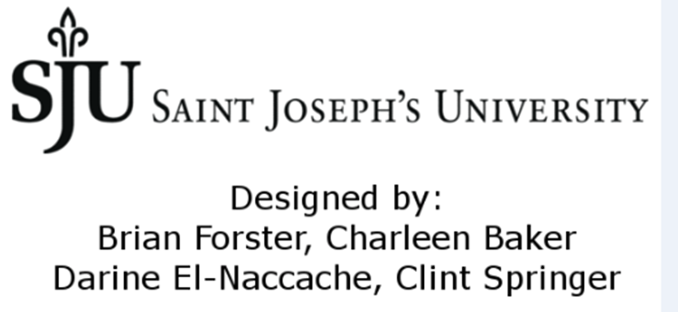
Domain Eukarya
Animal Kingdom:
Phylum Chordata
Green
Algae
Plant
Kingdom
Protist
Ancestor
Fungi
Kingdom
Protist
Ancestor
Animal Kingdom:
Invertebrates
Animal Kingdom:
Vertebrates
Bread mold
(Rhizopus)
Club fungi
(Basidomycota)
unicellular
Sac fungi
(Ascomycota)
Cartilaginous fish
Chlorophyta
multicellular
Chlorophyta
Charaphyta
Bryophytes
Pteridophytes
Gymnosperms
Angiosperms
Cnidaria
Lancelets
Birds
Domain Bacteria
Mammals
Domain Archaea
Choanoflagellate
Bony Fish
Nucleariids
Porifera
Amphibians
Platyhelminthes
Mollusca
Annelidia
Arthropoda
Echinodermata
Reptiles
Feathers
Hair
Mammary Glands
Amniotic Egg
Legs
Colonization of land
Lungs
Flowers
Colonization
of land
Vertebrae
Jaws
Seeds
Sexual spores
(internal)
Sexual spores
(external)
Protostomes
Bilateral symmetry
Body Cavities
Triploblastic Tissue Layers
Deuterostomes
Vascular Tissue
Sexual spores
True Tissues
Multicellularity
Colonization of land
Multicellularity
Loss of flagella
Colonization of land
Multicellularity
Acquisition of chloroplasts (Endosymbiosis)
Acquisition of nucleus and mitochondria (Endosymbiosis)
Universal Common Ancestor

Slide 3
Domain Eukarya
Animal Kingdom:
Phylum Chordata
Green
Algae
Plant
Kingdom
Protist
Ancestor
Fungi
Kingdom
Protist
Ancestor
Animal Kingdom:
Invertebrates
Animal Kingdom:
Vertebrates
unicellular
Cartilaginous fish
Chlorophyta
multicellular
Chlorophyta
Bryophytes
Domain Archaea
Pteridophytes
Lancelets
Mammals
Domain
Nucleariids
Amphibians
Bread mold
Porifera
Platyhelminthes
Mollusca
Annelidia
Echinodermata
Reptiles
1
5
6
7
9
10
11
13
15
17
19
Feathers
20
Amniotic Egg
Colonization of land
18
Lungs
4
Colonization
of land
16
Seeds
Sexual spores
(internal)
Sexual spores
(external)
14
Bilateral symmetry
Body Cavities
Triploblastic Tissue Layers
Jaws
Deuterostomes
3
Sexual spores
True Tissues
Radial Symmetry
Multicellularity
Colonization of land
12
8
Colonization of land
Multicellularity
2
Acquisition of nucleus and mitochondria (Endosymbiosis)
Universal Common Ancestor

