Slide 1
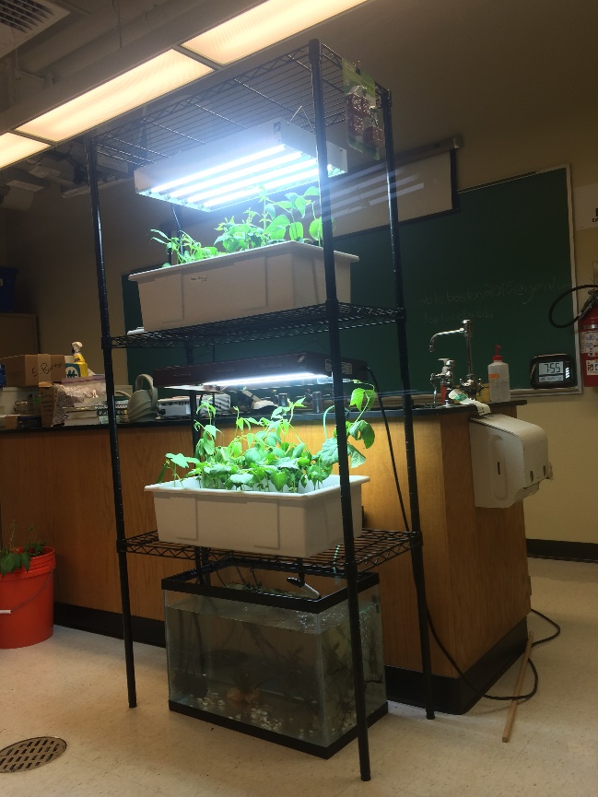




Teaching by
Way of
Aquaponics
Peter J. Park Michael Huster Catarina Mata
June 25, 2015

Slide 2
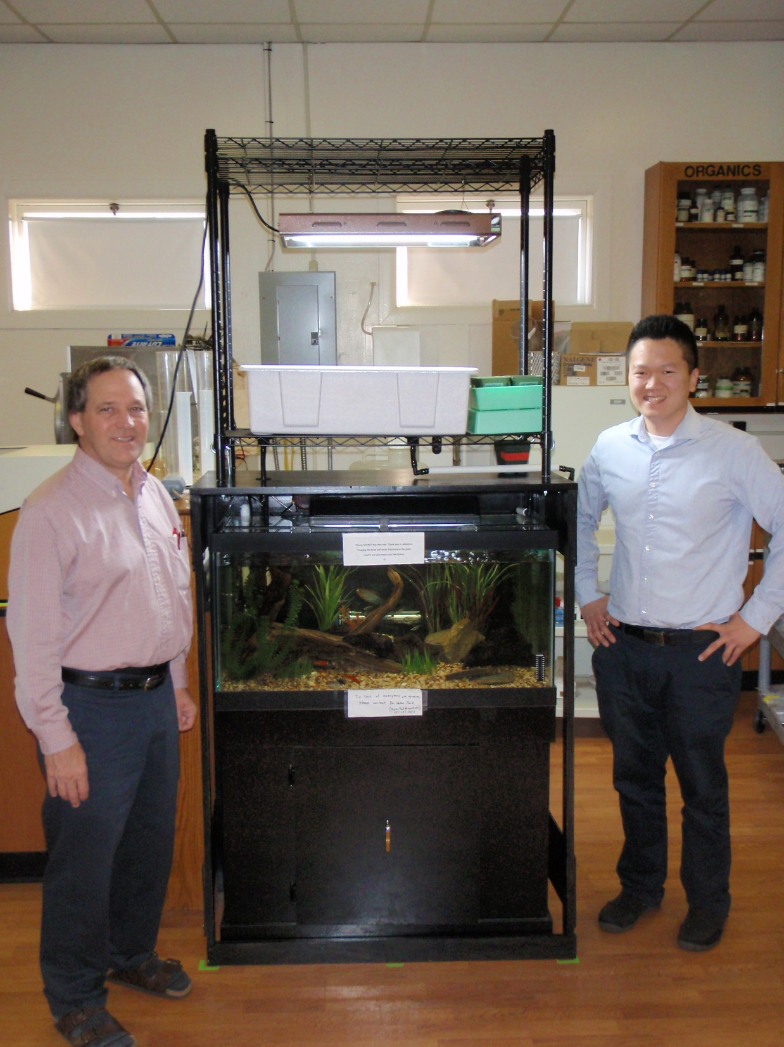
Nyack College’s Flood-and-Drain Aquaponics Unit
January 2013

Slide 3
Outline
Learning Goals
Sustainability: Ecological Context and “Practical” Science
Aquaponics: Underlying Biology
Aquaponics: Engineering Principles
In-class Applications of Aquaponics
Extension activities using an Aquaponics unit
Discoveries

Slide 4
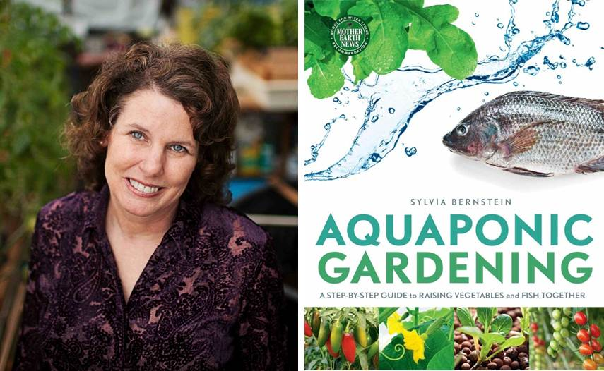
Learning Goals
Understand the biological processes and engineering principles underlying an aquaponic system.
Integrate knowledge of trophic cascade, nitrification, respiration, and photosynthesis.
Appreciate plant biology development
Collect one’s own data on and summarize patterns of growth in red kidney bean plants grown for at least three weeks in an aquaponic system and a non-aquaponic system.
Analyze these data with an emphasis on different types of variables.
Apply extension activities: (i) fish form and function (c.f., geometric morphometrics) and (ii) ecosphere science.
Invitation for you to use and adapt aquaponics in your classroom!

Slide 5
Outline
Learning Goals
Sustainability: Ecological Context and “Practical” Science
Aquaponics: Underlying Biology
Aquaponics: Engineering Principles
In-class Applications of Aquaponics
Extension activities using an Aquaponics unit
Discoveries

Slide 6
Industrial agriculture depends on….
fossil fuels
unlimited freshwater
stable climate
Are these resources renewable?
Are these resources sustainable?
Are these resources reliable?

Slide 7
Outline
Learning Goals
Sustainability: Ecological Context and “Practical” Science
Aquaponics: Underlying Biology
Aquaponics: Engineering Principles
In-class Applications of Aquaponics
Extension activities using an Aquaponics unit
Discoveries

Slide 8
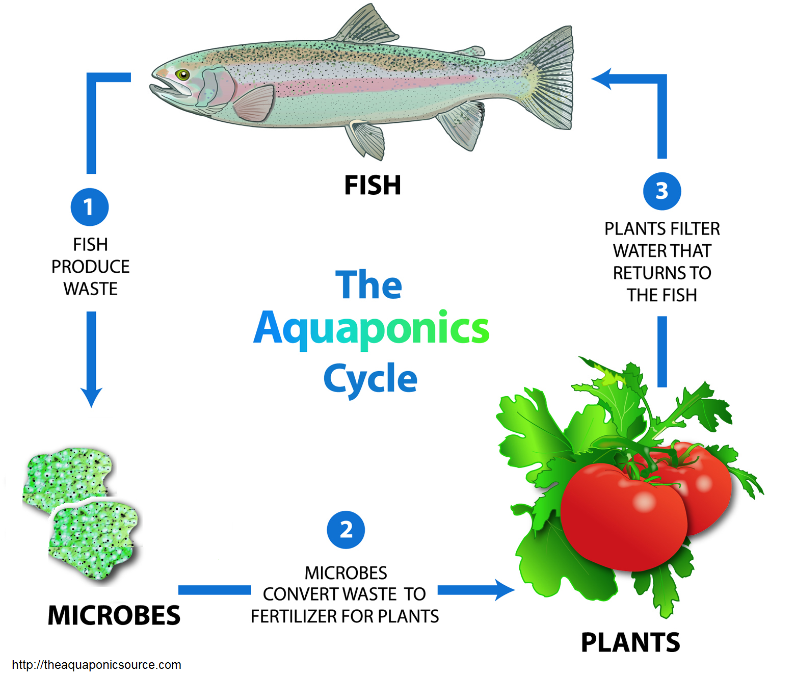
Aquaponics - a method of combining aquaculture (raising fish) and hydroponics (the soil-less growing of plants) that grows fish and plants together in one integrated system; can be achieved in small scales
http://youtu.be/3C3dM0ssTC8

Slide 9
Food Chain

Slide 10
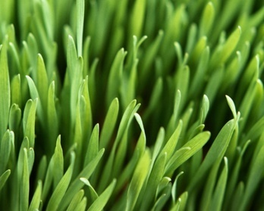
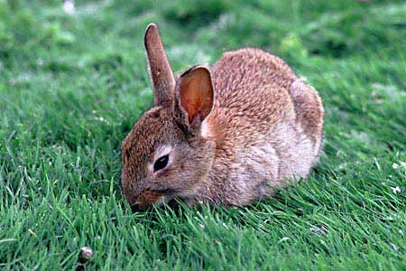
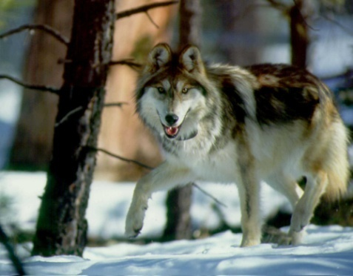
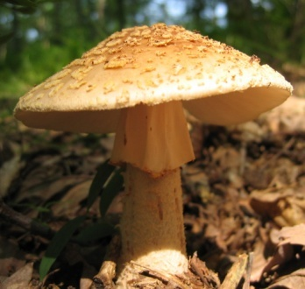
Producer
Herbivore
Predator
Decomposer

Slide 11
Producer
Decomposer

Slide 12
Nitrification

Slide 13
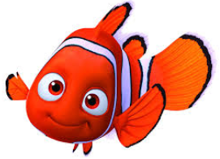

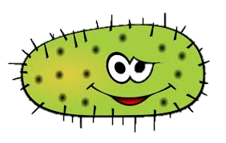
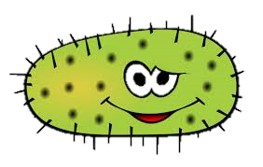
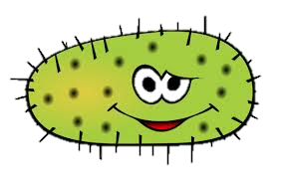
(Ammonia)
Nitrosomas

Slide 14
(Ammonia)
Nitrosomas

Slide 15


(Nitrite)
Nitrobacter

Slide 16
(Nitrite)
Nitrobacter

Slide 17



(Nitrate)

Slide 18
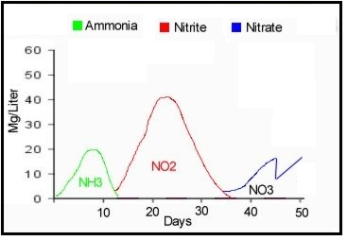

Nitrification
Water Change

Slide 19
Outline
Learning Goals
Sustainability: Ecological Context and “Practical” Science
Aquaponics: Underlying Biology
Aquaponics: Engineering Principles
In-class Applications of Aquaponics
Extension activities using an Aquaponics unit
Discoveries

Slide 20
Aquaponics @ Nyack College

Slide 21
IMPORTANT CONSIDERATIONS
- Fish stocking ratio of 0.1-0.2 lb of fish/gallon of tank water or 1lb of mature fish per 5-20 gallons of tank water. A mature plate-sized (12 in) tilapia weighs about 1.5 lbs (700 g) (pg. 73, Bernstein 2011)
Notes:
Water weighs 8.34 lb per gallon (1 kg per liter)

Slide 22
Benefits of Aquaponics
No soil to till
No need to mechanically remove weeds or spray herbicides
No soil-borne insects
No need to petroleum-based fertilizers and subsequent increasing acidity of soil
Much easier to harvest than soil-grown plants
No heavy lifting?
No need to fend off herbivores
Notes:
1:1 ratio of fish-rearing (water) volume to hydroponic media volume recommended if fish are stocked at a final density of 30g/L (Rakocy et al. 2006, Bernstein 2011)
Fish stocking ratio of 0.1-0.2 lb of fish/gallon of tank water or 1lb of mature fish per 5-20 gallons of tank water. A mature plate-sized (12 in) tilapia weighs about 1.5 lbs (700 g). (pg. 73, Bernstein 2011)

Slide 23
Risks of Aquaponics
Flooding - Mechanical (Don’t overfill tank level!)
Flooding, Drying Out - Electrical
Dependent on nitrification (This takes time!)
Dependent on external power source
Fish-keeping maintenance – Feeding, pH, ammonia

Slide 24
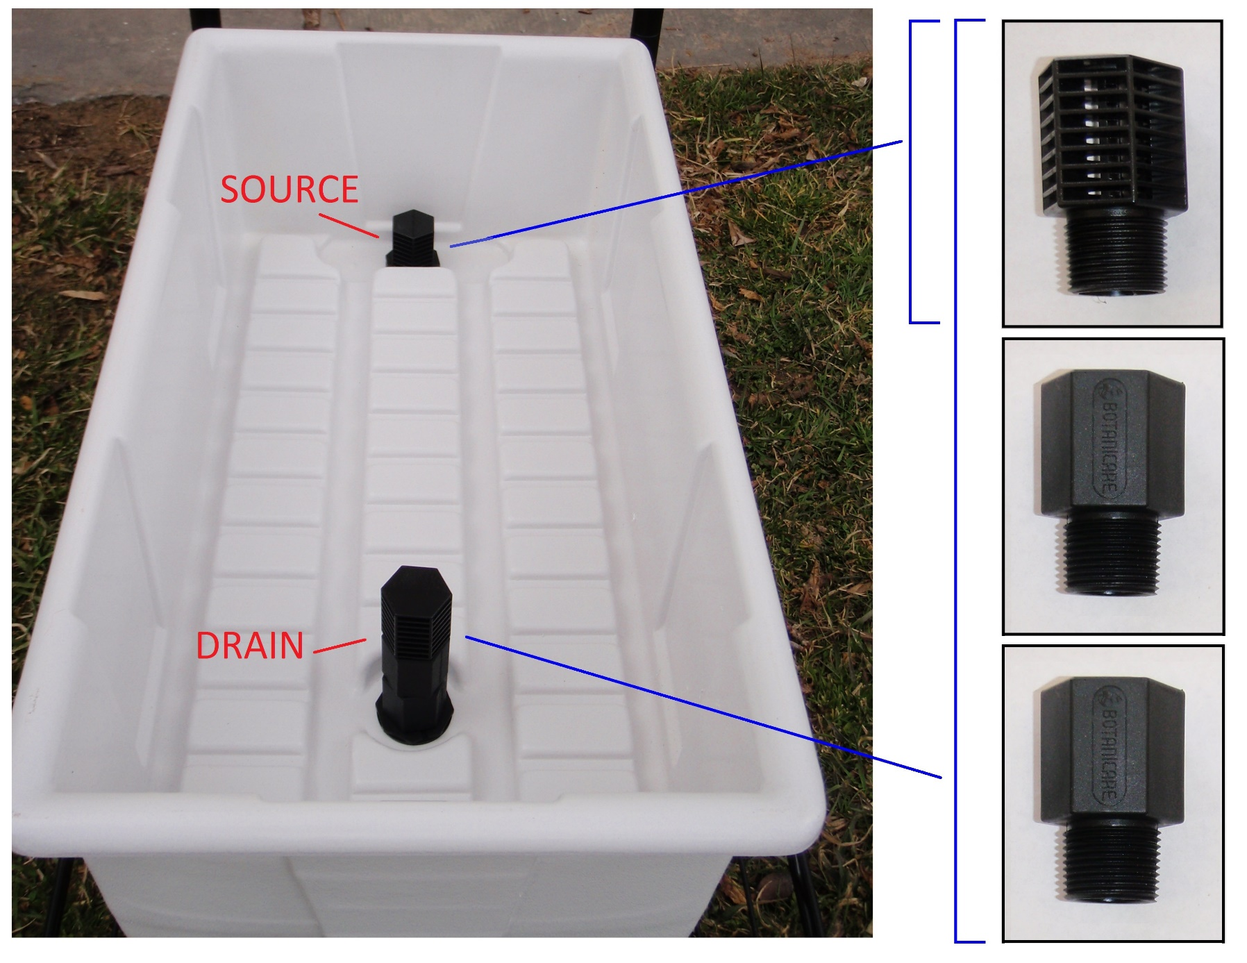
Growing Bed (aerial view)

Slide 25
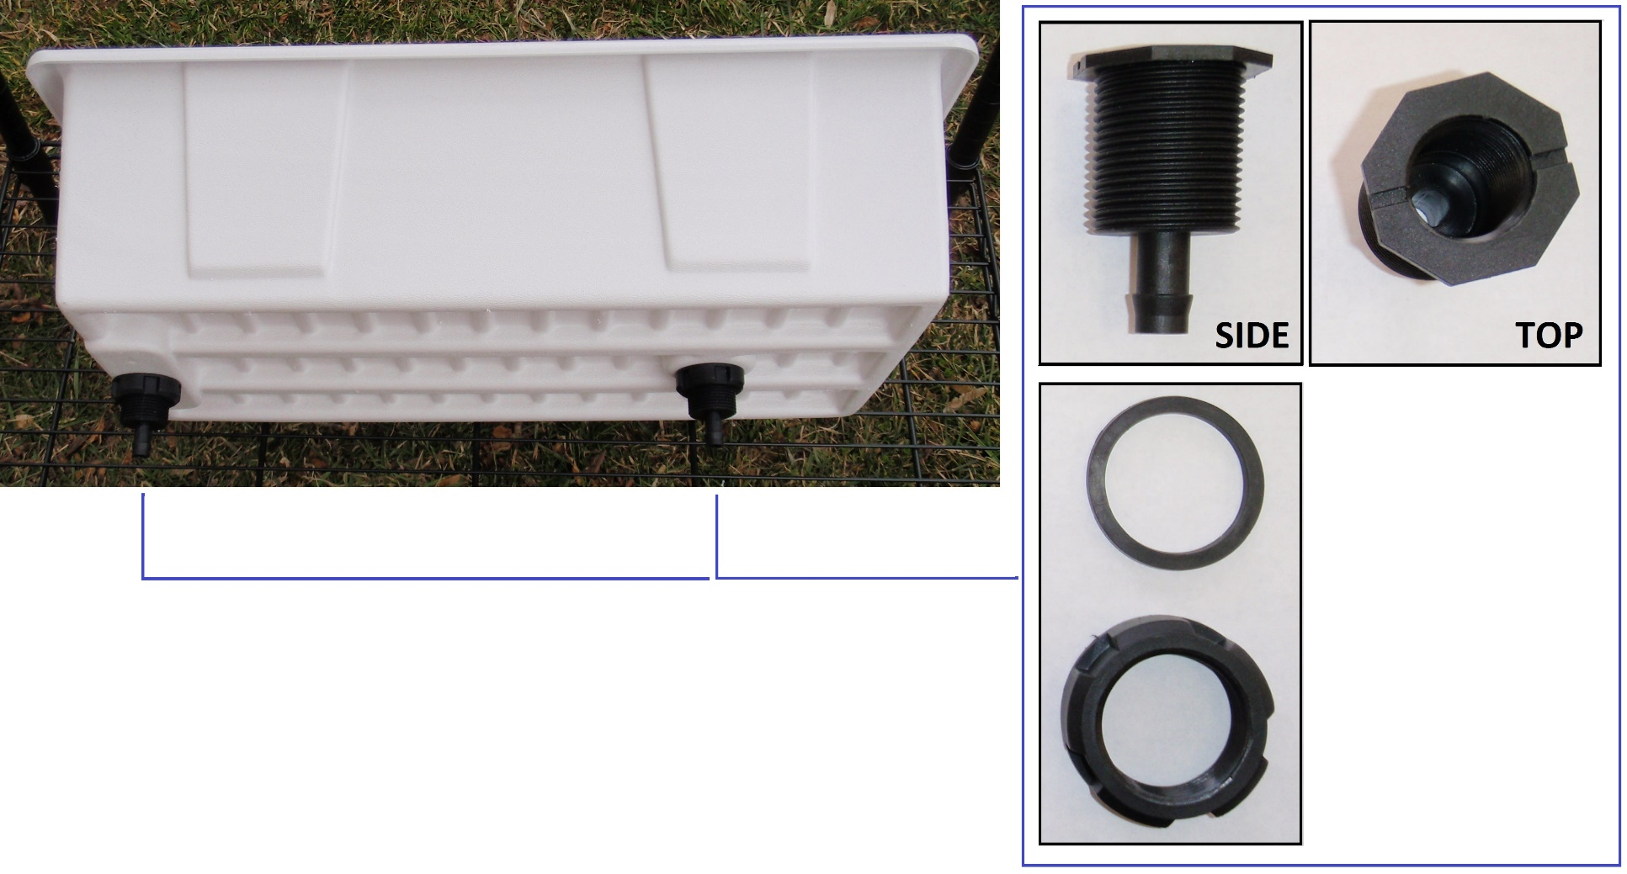
Growing Bed (side view)

Slide 26
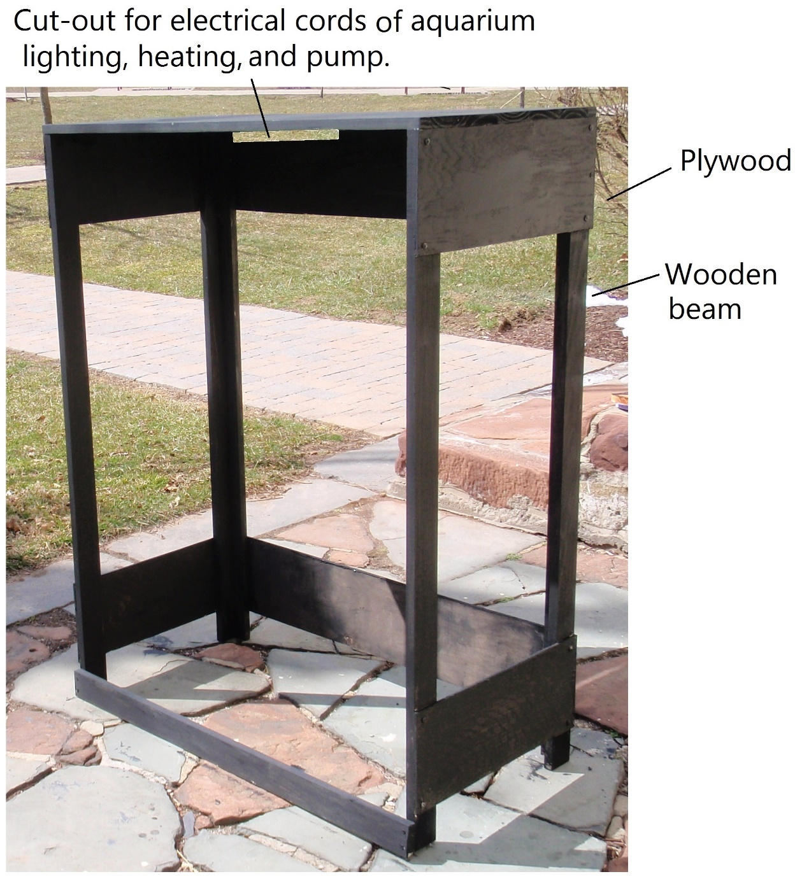
Support Stand

Slide 27
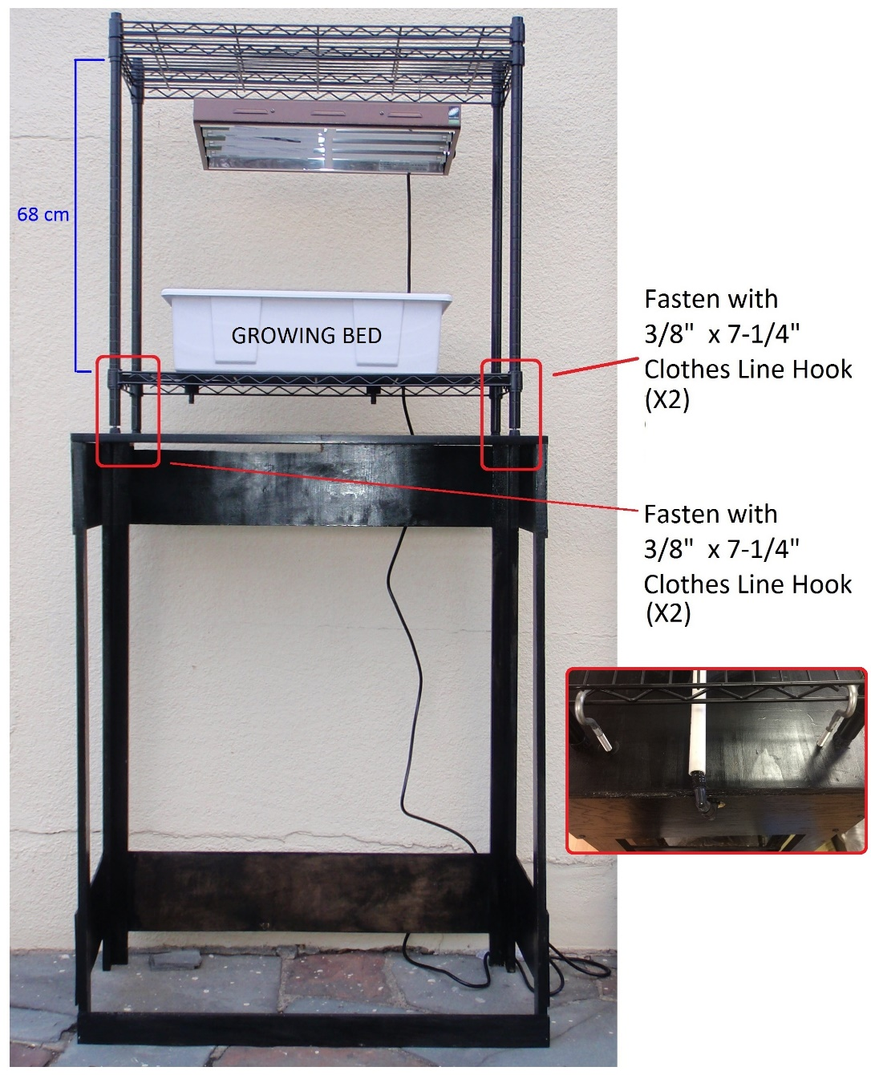
Aquaponic Unit = Growing Bed + Shelving + Support Stand

Slide 28
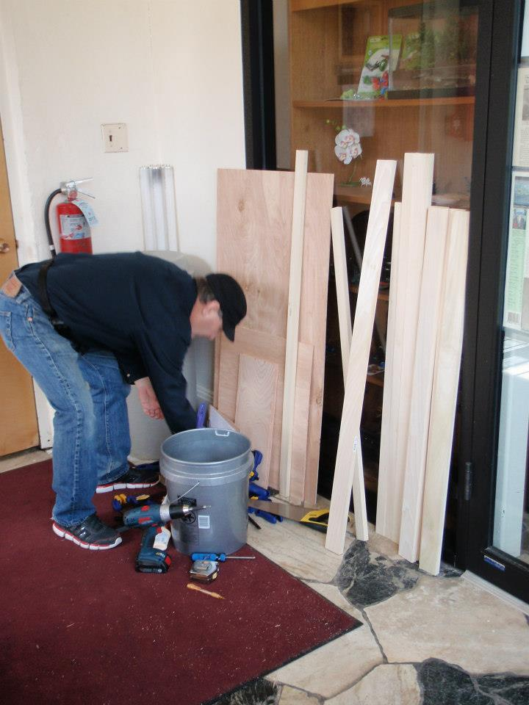
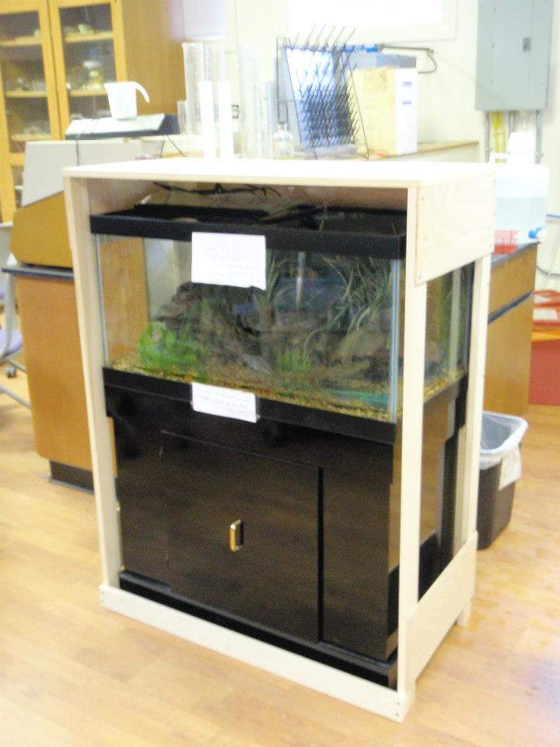
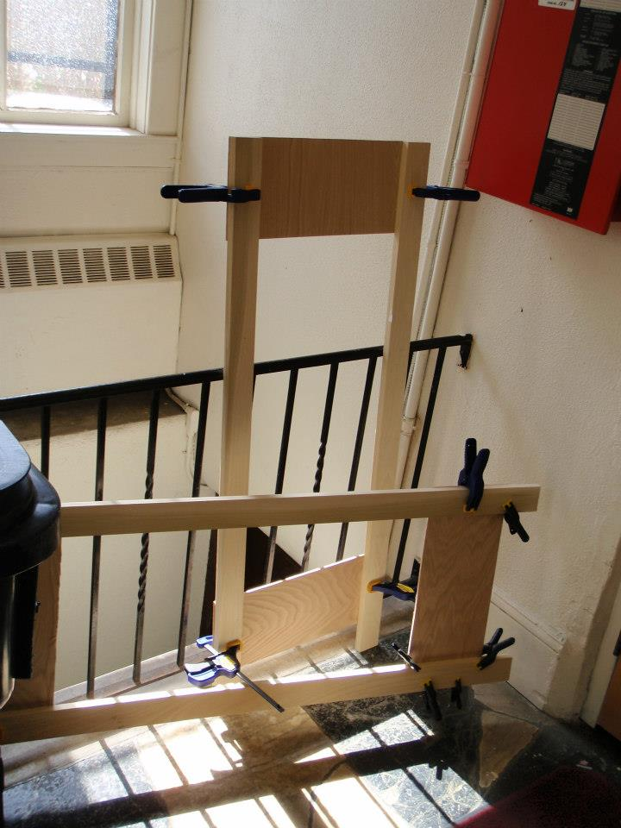
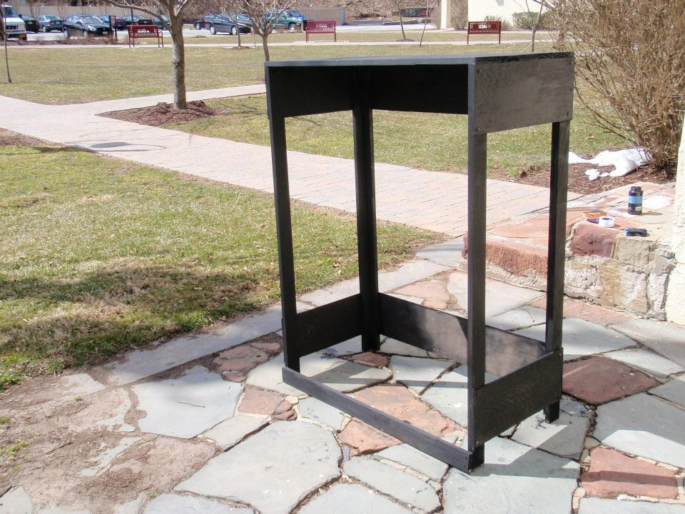
Winter 2012

Slide 29
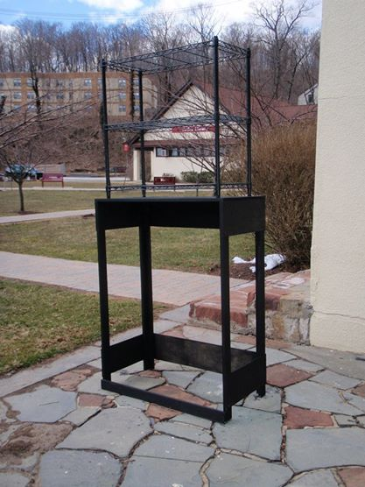
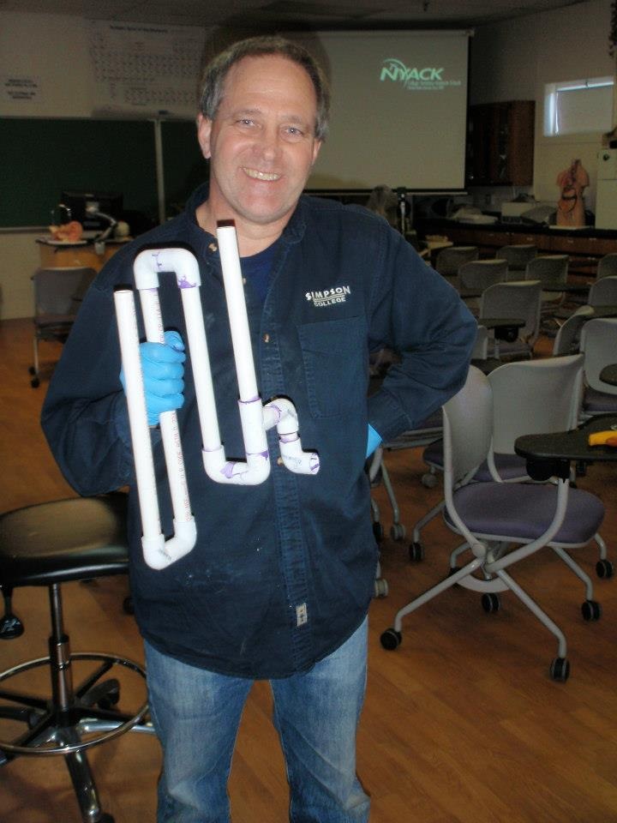
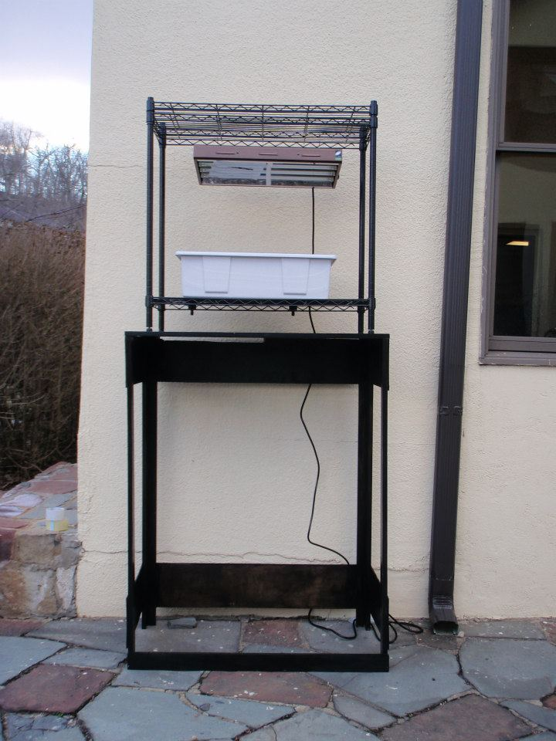
DYI Overflow
Check
Winter 2012

Slide 30
Nyack College’s Flood-and-Drain Aquaponics Unit
Winter 2012

Slide 31
Outline
Learning Goals
Sustainability: Ecological Context and “Practical” Science
Aquaponics: Underlying Biology
Aquaponics: Engineering Principles
In-class Applications of Aquaponics
Extension activities using an Aquaponics unit
Discoveries

Slide 32
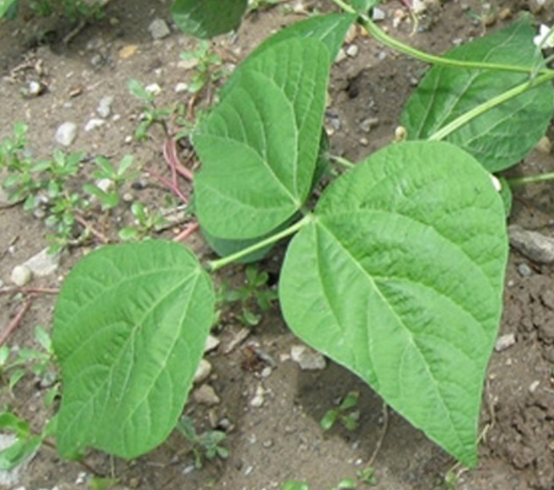
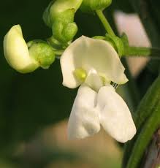
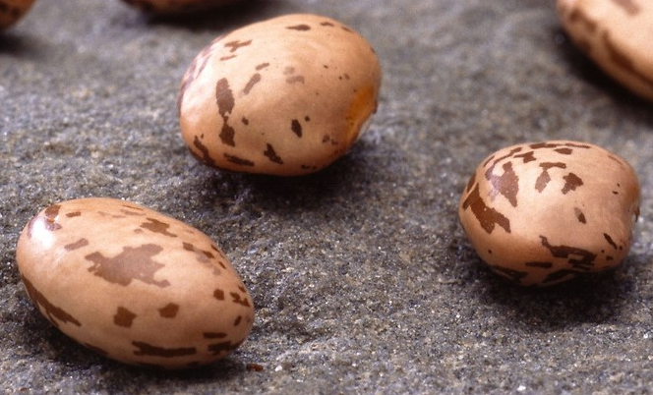
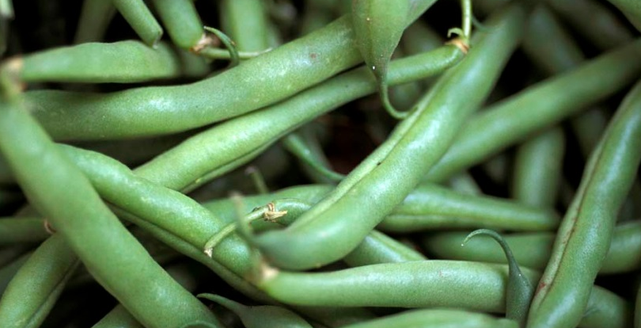
Aquaponics, the plants
Beans - Phaseolus vulgaris L., Fabacea
- Herbaceous annual fast growers
- Seed and fruit edible
Seed to flower in about 5 weeks
Trifoliate leaf
High nutrient needs
Easy to tell if in Low N –Yellow leaves
Photos from gobotany

Slide 33
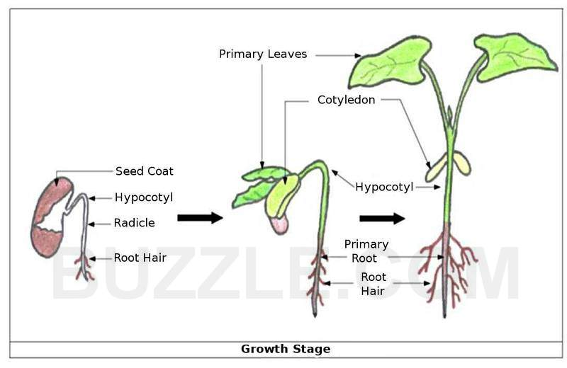
Early development
Image from www.buzzle.com

Slide 34
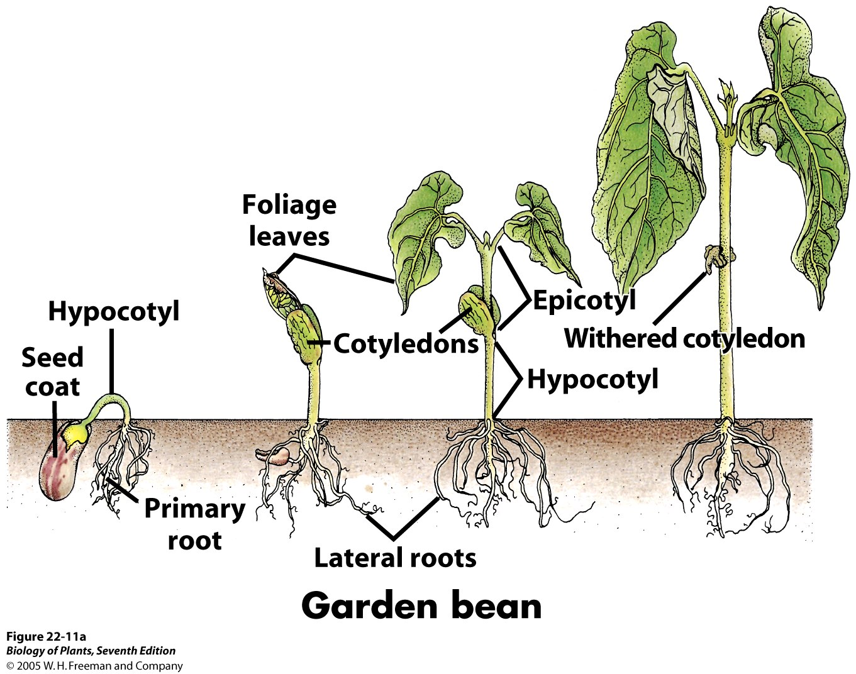

Slide 35
Plant Measurements
Length
Leaf area, measured or estimated
Total chlorophyll on leaves
Flower number
Seed pod length and mass
Photosynthesis / Respiration
Leaf area ratio
Growth RGR
http://plantsinaction.science.uq.edu.au/edition1/?q=content/6-1-2-plant-biomass

Slide 36
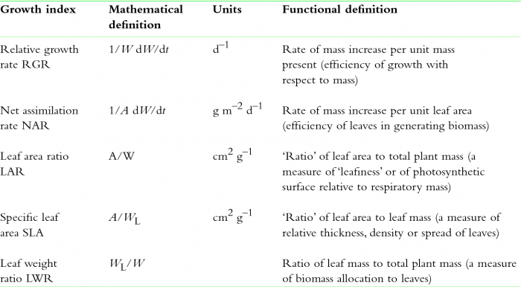
Plant Biomass
http://plantsinaction.science.uq.edu.au/edition1/?q=content/6-1-2-plant-biomass

Slide 37
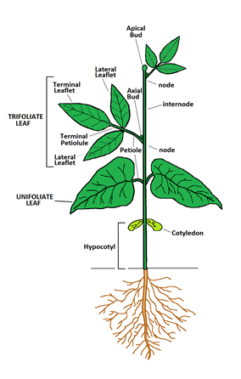

Slide 38
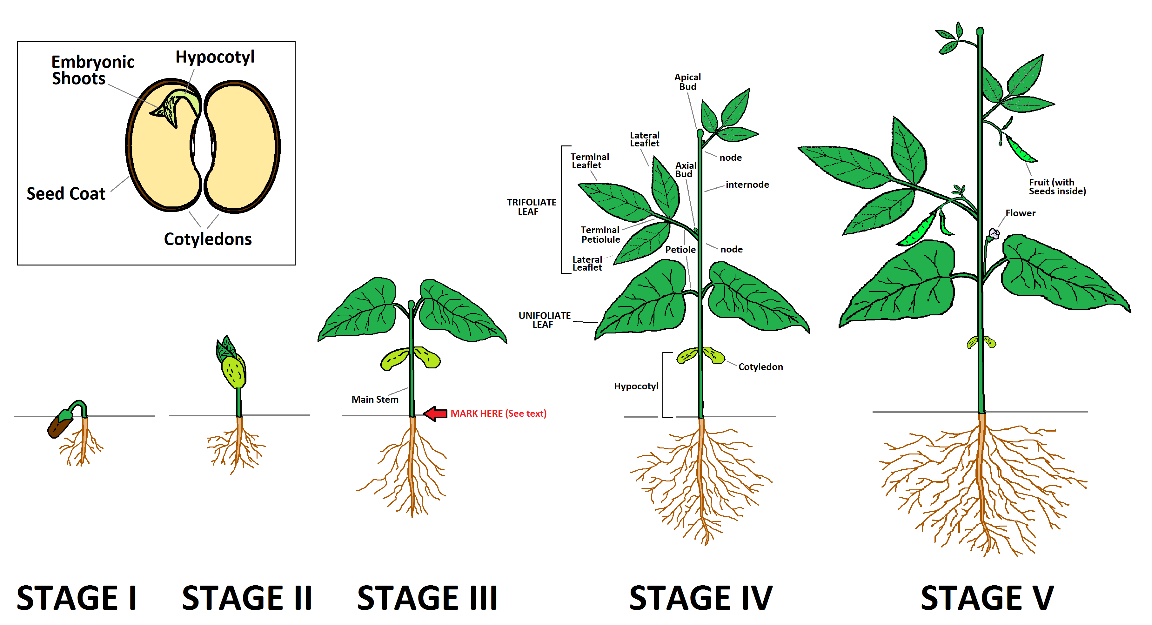

Slide 39
Leaf Number as a proxy for developmental growth?
Image adapted from http://ohhs.ohsd.nt/~brick/pla/images/plai_seeds_dicots_bean.jpg

Slide 40
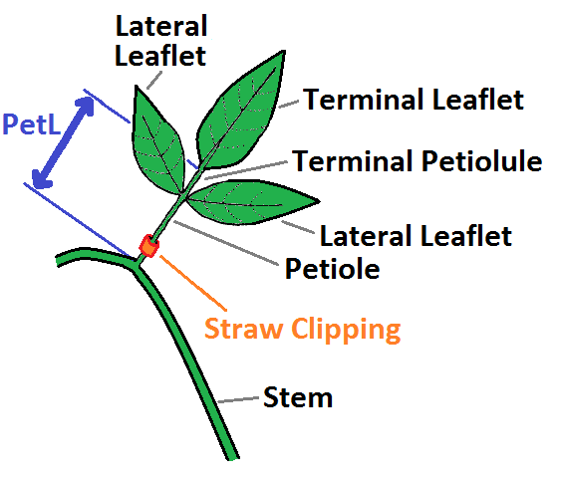
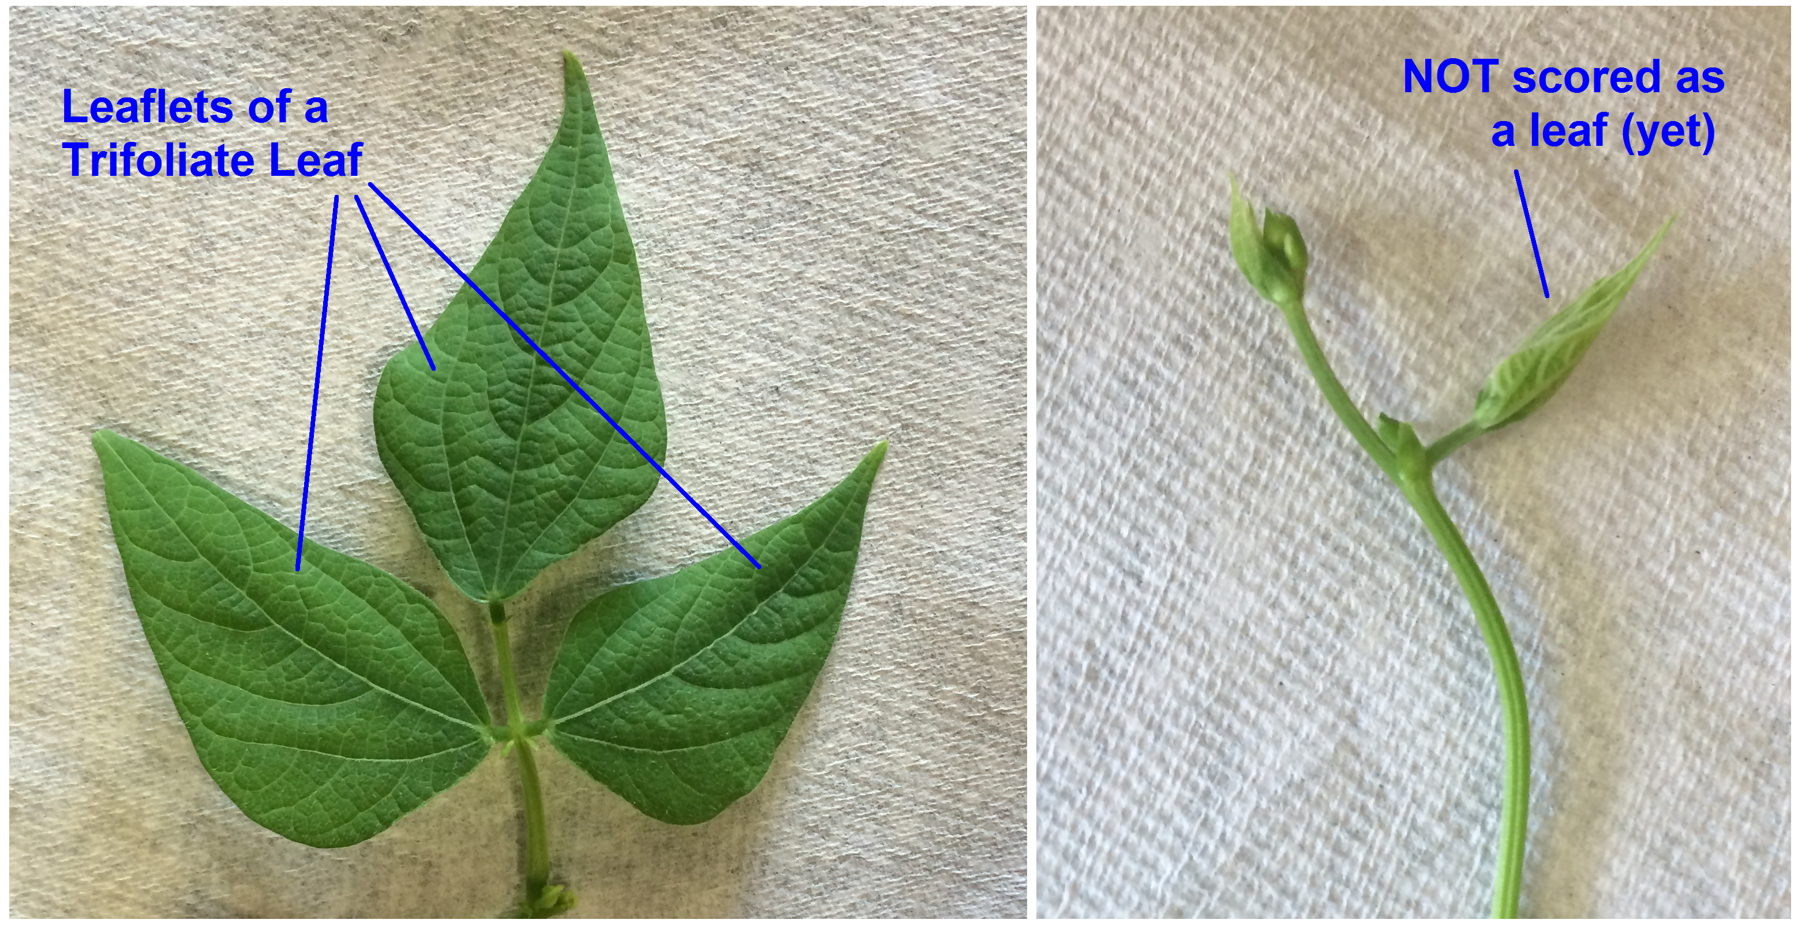
What to count as a leaf?

Slide 41
Which of the following plant traits is (are) the best indicator(s) for healthy plant growth?
(a) Plant height
(b) Plant weight
(c) % Shoot allocation
(d) Number of leaves
(e) All of the above

Slide 42
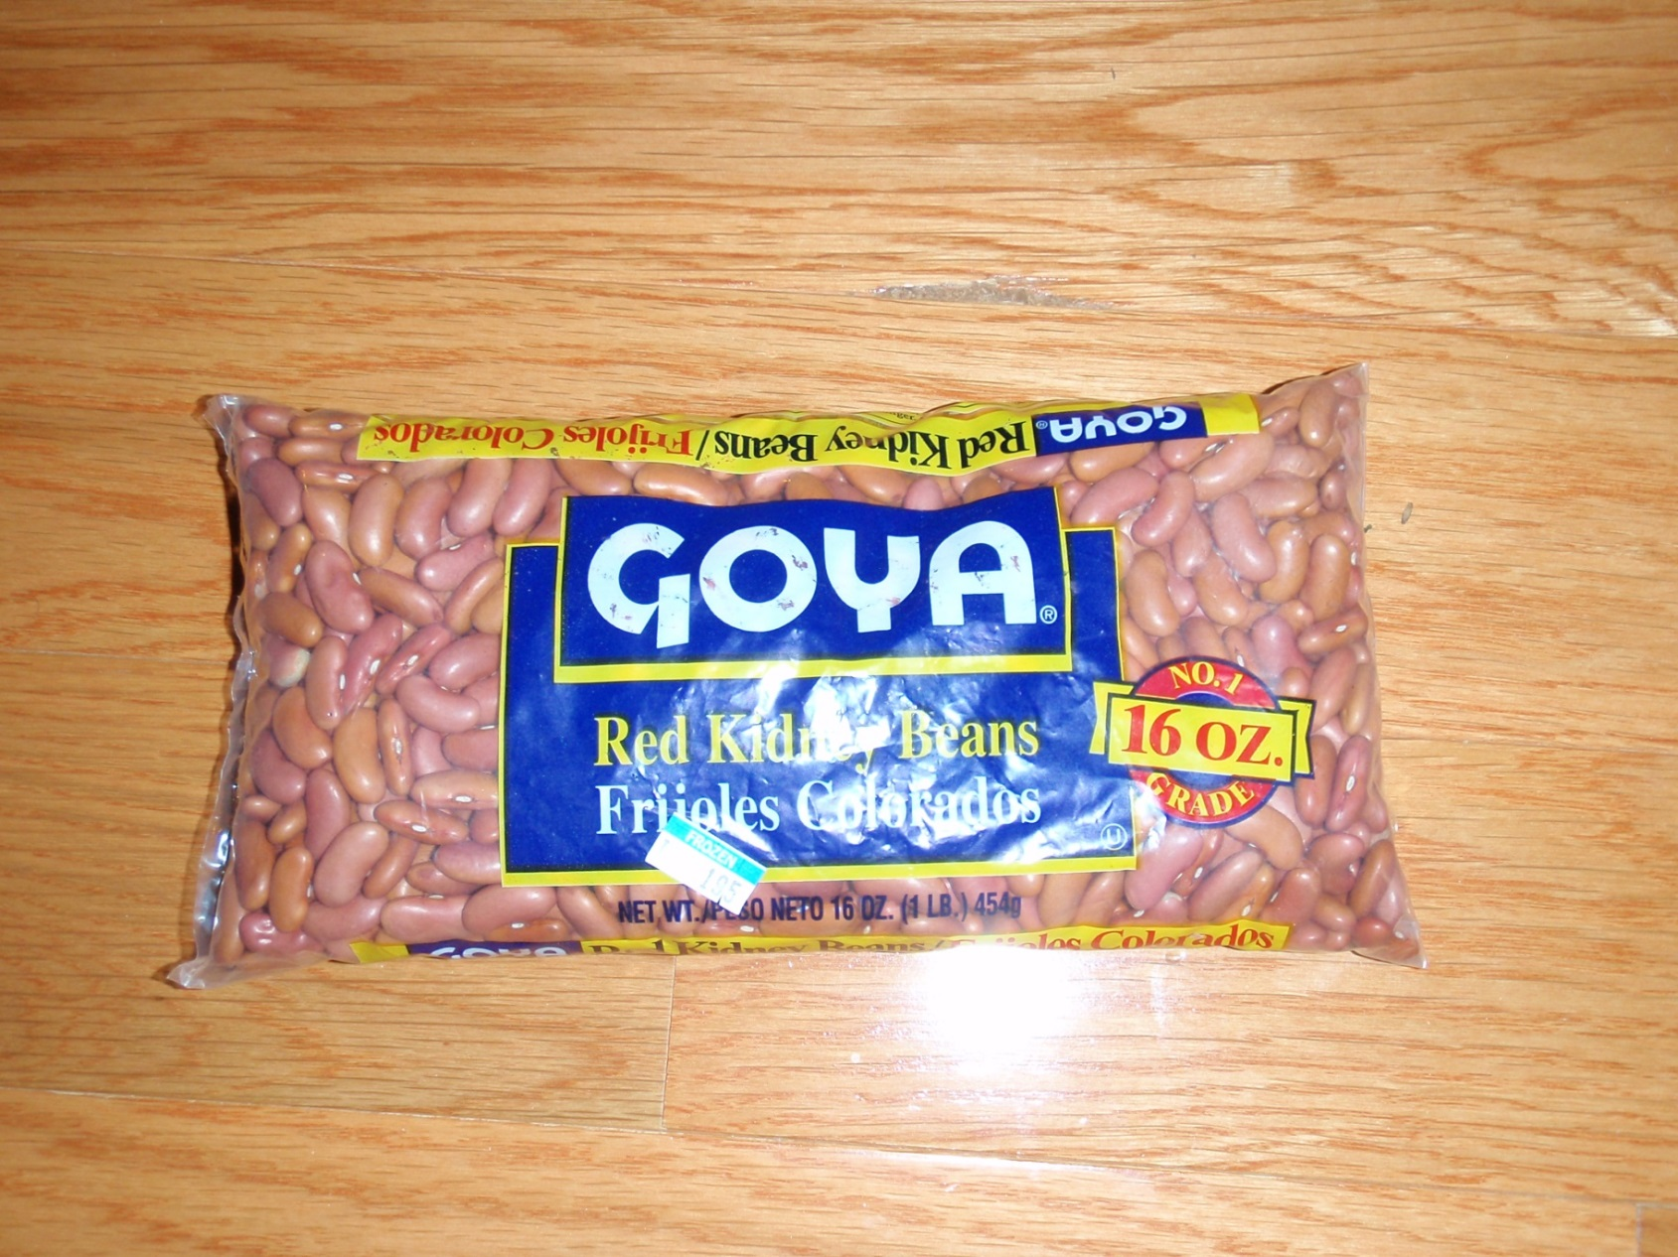
Aquaponics as way to provide a real research experience.

Slide 43
FALL 2014: THE “BASIC” EXPERIMENT

Slide 44
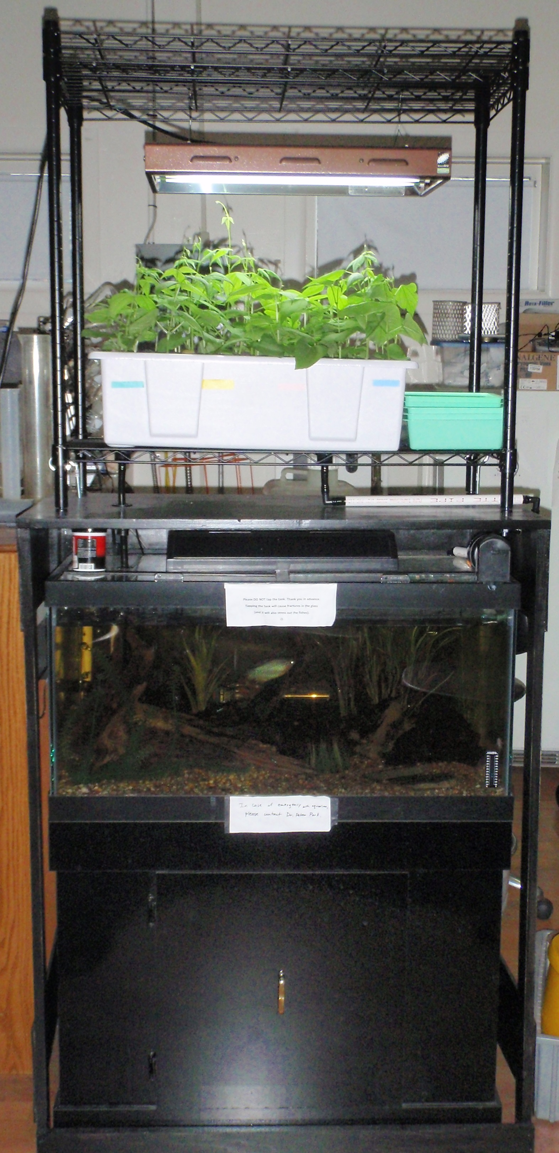
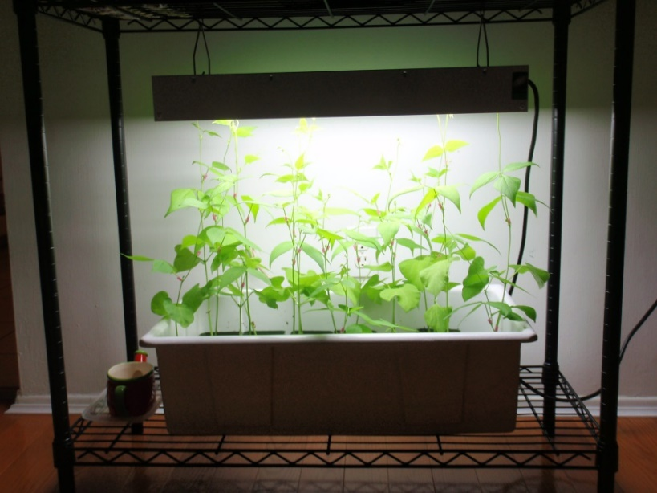
AQUAPONICS
SOIL

Slide 45
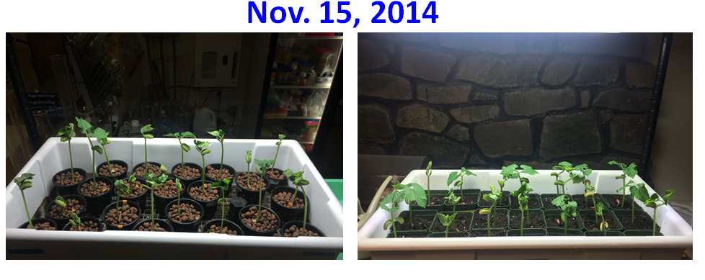

Slide 46
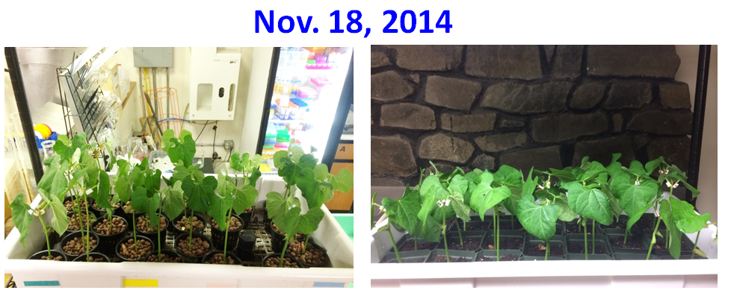

Slide 47
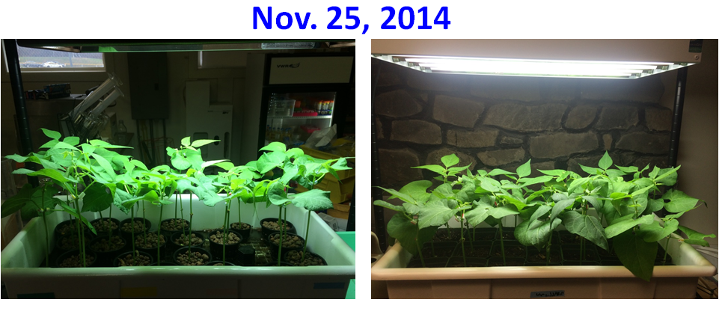

Slide 48
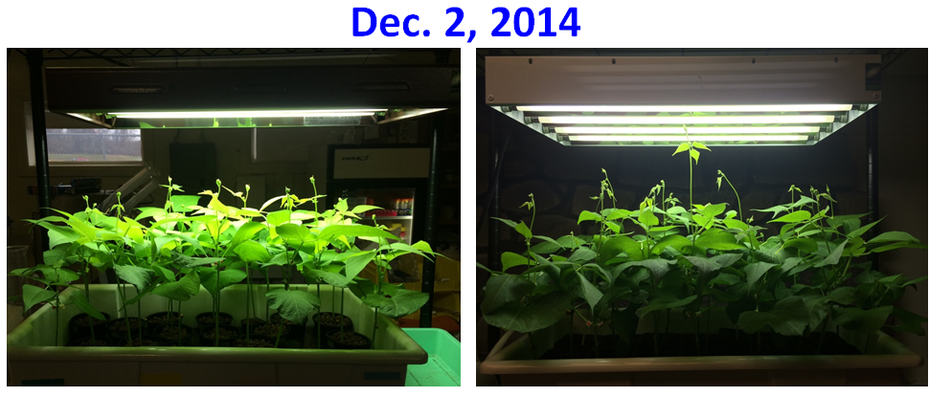

Slide 49

(n=21)
(n=21)

Slide 50
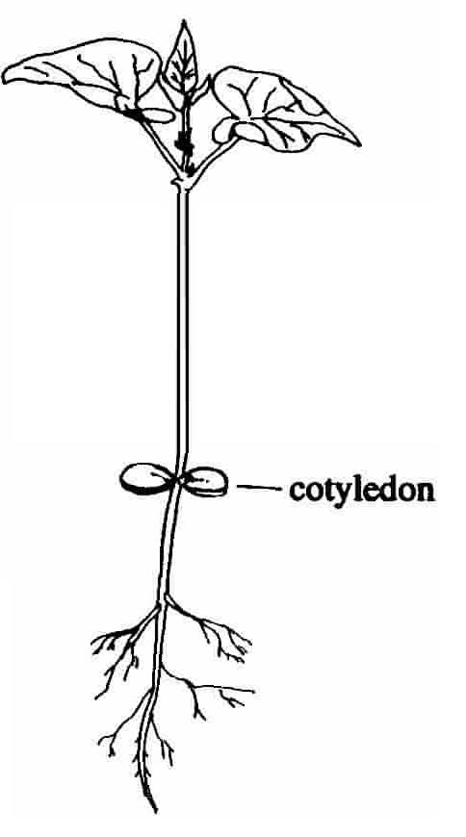
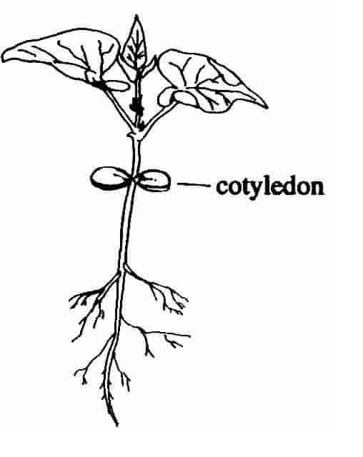
Week 3: Average Plant Height (cm)
AQUAPONICS
SOIL
<
Notes:
Data recorded at end of expt.

Slide 51
(n=21)
(n=21)
Notes:
Data recorded at end of expt.

Slide 52
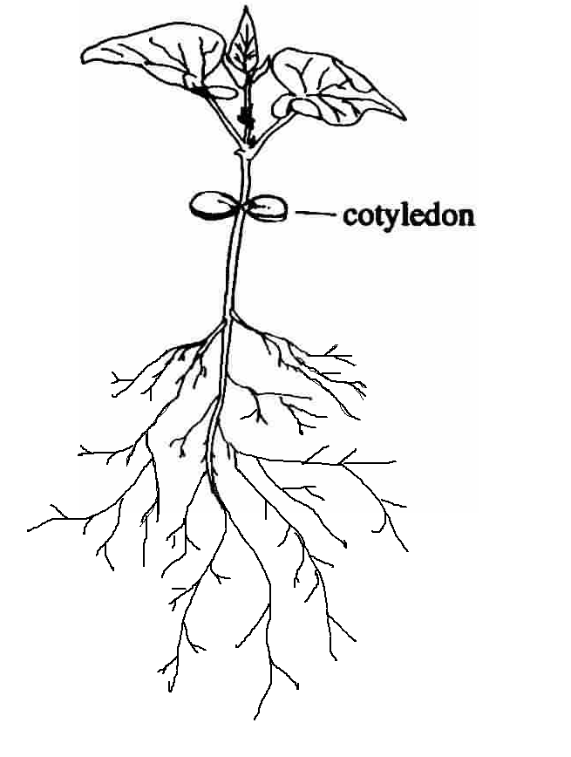
Week 3: Average Total Dry Weight (g)
AQUAPONICS
SOIL
=

Slide 53
Leaf Number as a proxy for developmental growth?
Image adapted from http://ohhs.ohsd.nt/~brick/pla/images/plai_seeds_dicots_bean.jpg

Slide 55
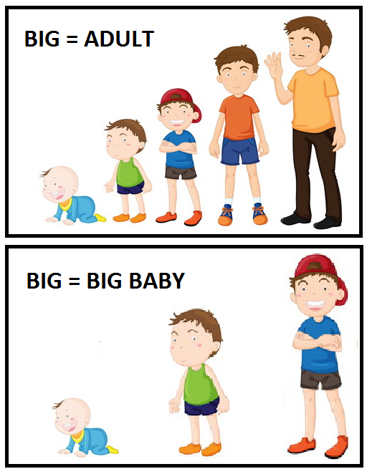
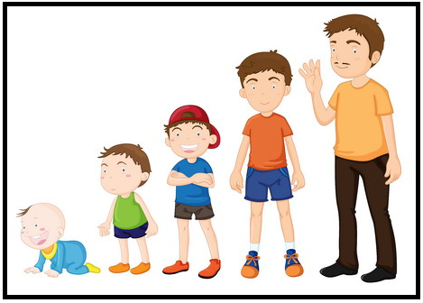
WHAT DOES SIZE TELL US?
Notes:
Proxy for puberty = amount of hair, smell of sweat, etc.

Slide 56
What effect does aquaponics vs. soil have on plants?
Compared to soil plants, aquaponic plants are…
Shorter
Similar in weight
Spending a lot of their internal resources on root growth (Does this mean the environment is nutrient rich or poor?)
If leaf number is a good indicator of plant maturity, then they are similar in developmental stage to soil plants (c.f., double light expt) over the same time span.

Slide 57
Datasets available as Appendices!
Basic Experiment (Reference)
Light Duration
Plant Density

Slide 58
WHAT ELSE CAN YOU DO WITH AN AQUAPONICS UNIT IN THE CLASSROOM?

Slide 59
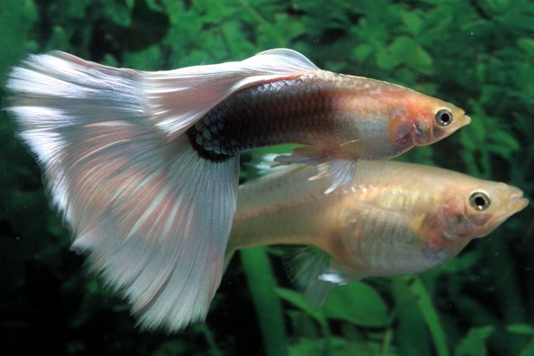
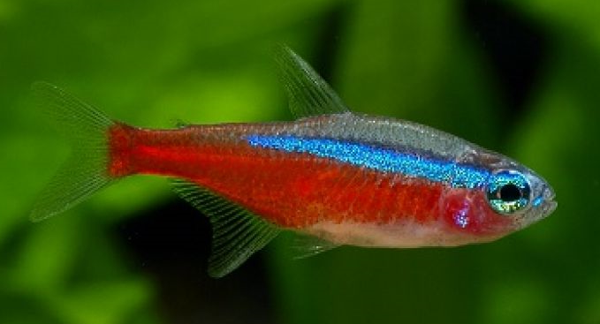
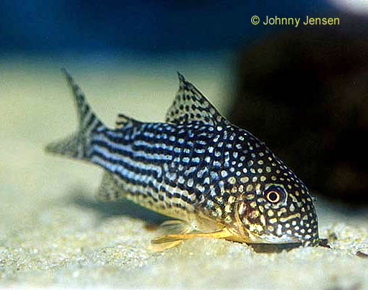
EXTENSION #1

Slide 60

What about the fish?
No, we don’t consume any fish raised in the science lab.
See Foraging Niches Lab in pgs. 184-197 of Kingsolver (2006)

Slide 61

EXTENSION #2
See White and Maskiewicz (2014)

Slide 62




Big Picture?
Outside of Nyack…
Michael Amadori
Global Service Outreach
At Home Use
Notes:
Read Quote:
“This results in a continuous strain on environmental and fiscal resources from both the production side and disposal side of modern food production. An average university campus is no different and will purchase, distribute, and dispose of food for thousands of students every day. Thus, substantial cost savings and environmental benefits could be realized by using food waste as a valuable resource for food production and diverting it from a landfill.”

Slide 63




Big Picture?
Barrel-Ponics® systems
Arduino-based, urban aquaponics
Disney kids
Connections overseas (Rick Harner)
http://www.fastonline.org/
Eric Maundu
http://youtu.be/3IryIOyPfTE
http://video.disney.com/watch/disneychannel-pass-the-plate-aquaponics-4e879b81b29bfcca9da2bc2f

Slide 64

Acknowledgements
ABLE
Roberta Williams Laboratory Teaching Initiative Grant (2012)
Boston University
Angela Seliga
Kathryn Spilios
Barkha Shah
Staff!
Nyack College
Dept. Natural Sciences
Jacqueline Washington
Fernando Arzola Jr.
Nina Balmaceda
Our students!
Stony Brook University
Michael Axelrod
John Klumpp
Stephen Abrams
Niamh B O'Hara
Hydroponics Stores
Hydroponic Garden Centers (Flushing, NY)
Harvest Moon Hydroponics (Central Nyack, NY)
GyoStuff (Cambridge, MA)
All ABLE 2015 workshop participants!

